Slide 1
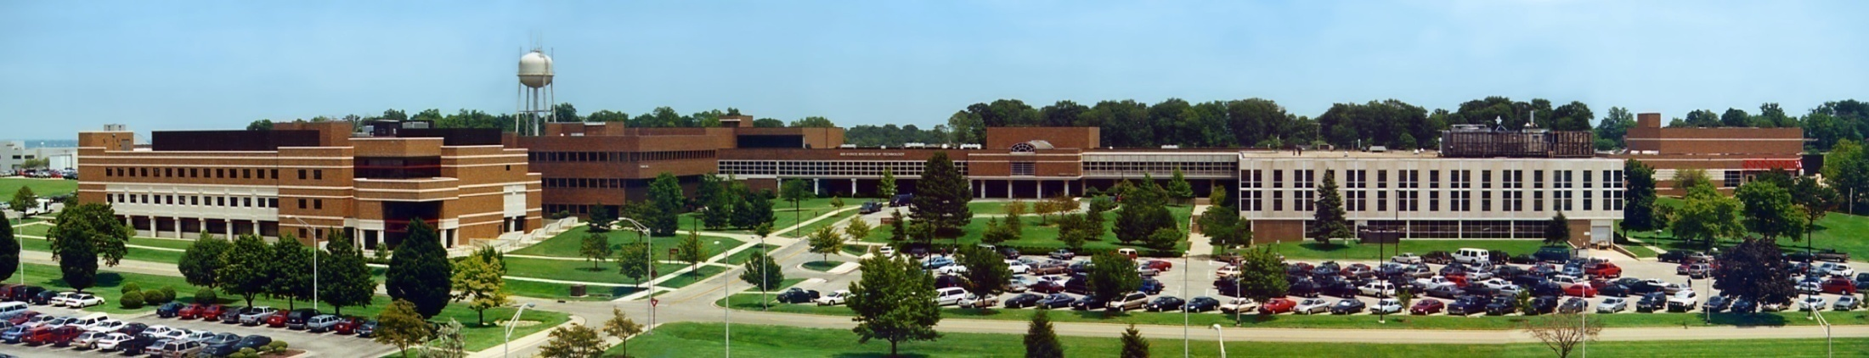
CSCE 693 – Software Evolution Designing Video Game Hardware
Air Force Institute of Technology
Douglas D. Hodson, PhD
Bldg 640, Rm 311C
255-3636 x4719

Slide 2
Part V – CPU Designs (Highlighted Comments)

Slide 3
Table of Contents
Part V – CPU Designs
Chapter 25: The ALU: Arithmetic Logic Unit
Chapter 26: A Simple CPU
Chapter 27: A Configurable Assembler
Chapter 28: Racing Game With CPU
Chapter 29: A 16-bit CPU
Chapter 30: Framebuffer Graphics
Chapter 31: Tilemap Rendering
Chapter 32: Scanline Sprite Rendering
Chapter 33: A Programmable Game System
Chapter 34: A Demo Program

Slide 4
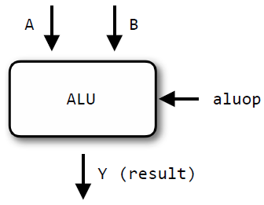
Chapter 25 – The ALU
ALU : Arithmetic Logic Unit
Takes two operands A and B, computes an operation (aluop) on them
Combinational circuit, NOT sequential

Slide 5
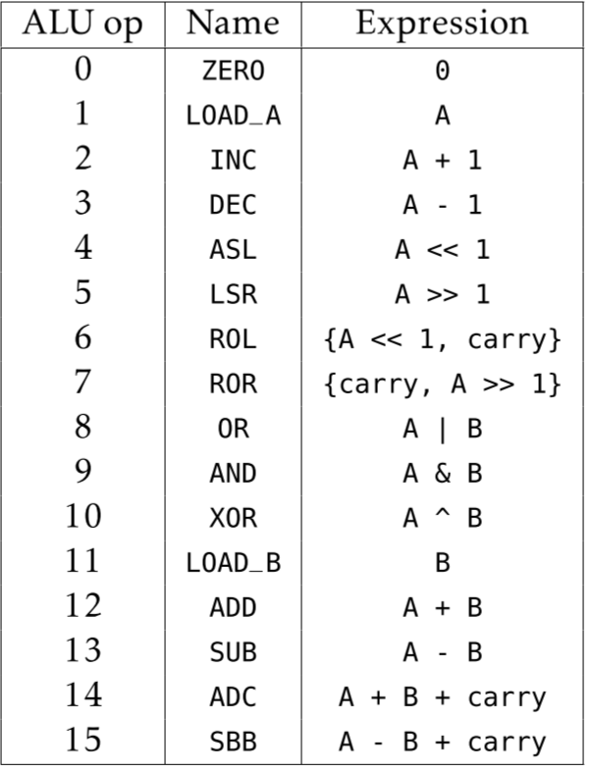
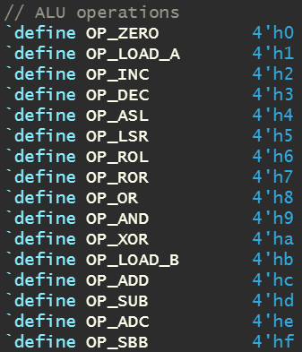
ALU Operations

Slide 6
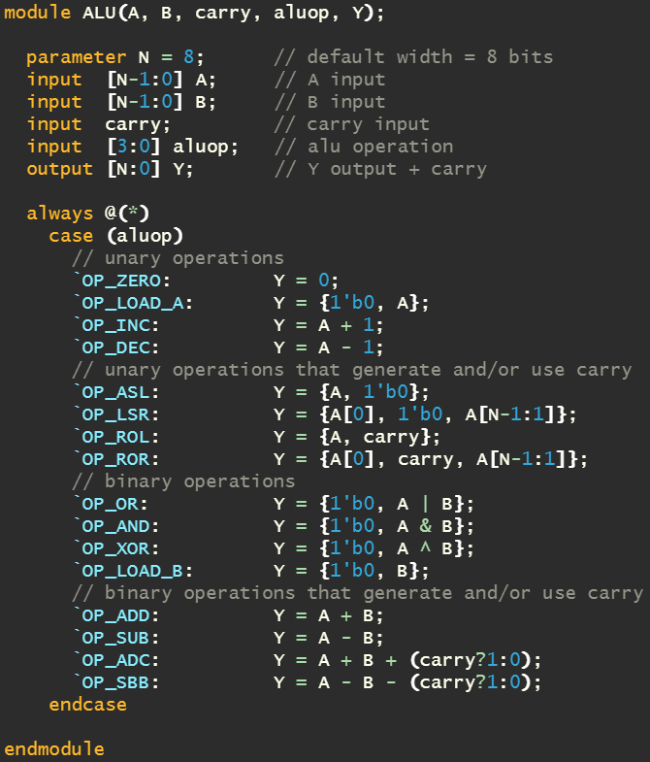
ALU Implementation

Slide 7

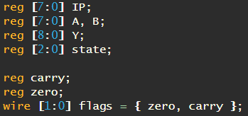
Chapter 26 – A Simple CPU
FEMTO-8
8-bit data inputs or operands
8-bit address bus (can address 256 bytes of memory)
Instructions are variable length
No interrupt functionality
A and B registers are 8-bits wide
Y register used to store output from ALU
Instruction pointer (IP) is 8-bits
CPU named “FEMTO” because it sounded cool

Slide 8
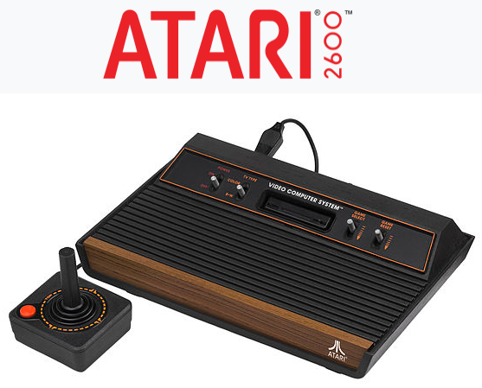
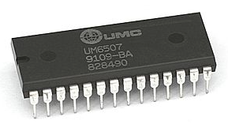
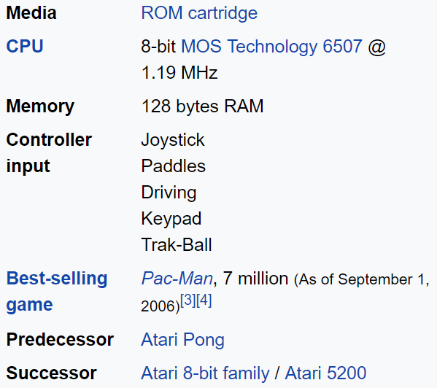
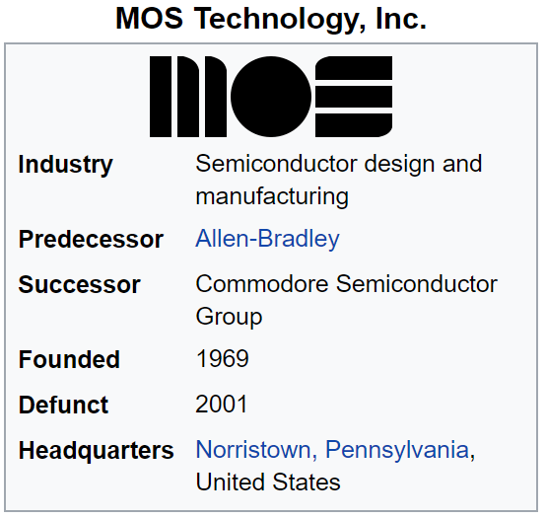
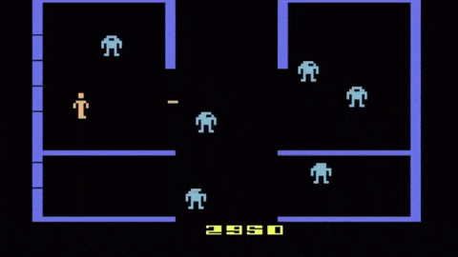
MOS Technology 6507
6507: 8-bit microprocessor
Essentially a 6502, but
Smaller, cheaper
Address line A15-A13 and some other signals such as interrupt lines are not accessible
Therefore can address 8KB of memory (2^13)
Oriented at small-scale embedded systems, not general-purpose computers

Slide 9
CPU Common Traits
A number of registers which store internal state
An instruction set which the CPU interprets in a fetch-decode-execute cycle
The ALU or arithmetic logic unit which computers math and logic functions
An address bus which identifies which external components (e.g., RAM, ROM) and which address to read or write
A data bus which contains the data to send of receive from external components
An instruction pointer (or program counter) that contains the address of the next instruction to execute
Fetch (an instruction from memory)
Decode (figure out what to do)
Execute (carry out instruction in a prescribed order)

Slide 10
CPU Design: Competing Goals
Maximizing code density
Define a rich set of instructions to reduce code size
Simplify decoding
Design instructions to be easily decoded for execution
FEMTO does this be defining some bits to have consistent meaning across multiple opcodes
Bits 0-3 encode ALU operation
Bits 4-5 encode destination register
Bit 6 is set if the ALU input read from the data bus, otherwise it reads from register B
Modern CPUs decode instructions into micro-operations

Slide 11
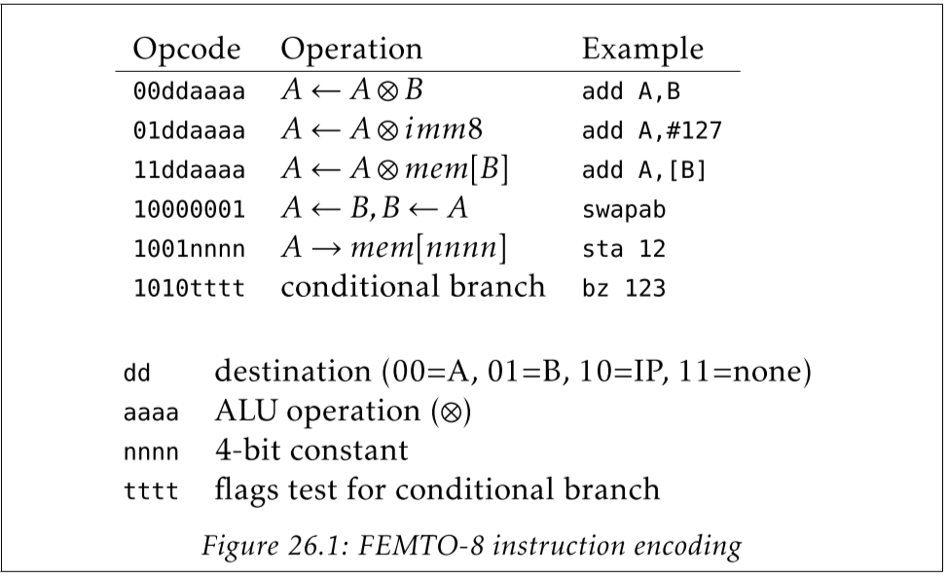
FEMTO-8 Instruction Encoding
Think operations and less about instructions
ALU operations ≠ CPU opcodes
This table present the encoding, examples are few, not all mnemonics!

Slide 12
Assembly Mnemonic Syntax
Examples
add A,B : adds the value in register B to register A, storing the result in A
add A, #127: adds the constant value 127 to A (immediate mode)
add A, [B]: fetches the data at address B, then adds it to A

Slide 13
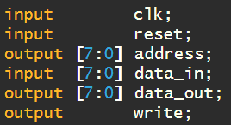
High Level Interface
Clock
Reset
Address to read from or write to
Data input
Data output
Write signal to indicate reading or writing

Slide 14
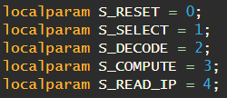
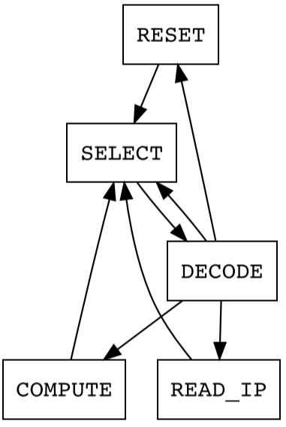
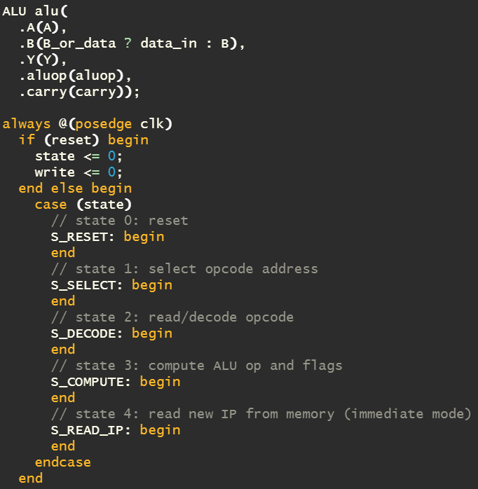
CPU State Machine
SELECT: fetch the next opcode and increment the instruction pointer
DECODE: latch the opcode from the data bus and determine what’s next: write to memory, or proceed to the COMPUTE or READ_IP states
COMPUTE: latch the output of the ALU into a register, set carry and zero flags
READ_IP: used for taken conditional branches; reads a new IP from memory

Slide 15
Important!
Nowhere in the FEMTO-8 source code will you find “instructions” listed
You will find a state machine designed with certain features and capabilities
The job of the assembler is to map (encode) human readable instructions (mnemonics) to those capabilities

Slide 16
Verilog Compiler Directives
A directive is used to control the compilation of a Verilog description
(`) denotes a compiler directive
Examples
`include : insert the entire contents of a source file into another file
`define : define text macros
`undef : remove text macro definitions
`ifdef : checks to see if a macro has been defined to optional include source code
`timescale : specified the time unit and precision of the modules that follow

Slide 17
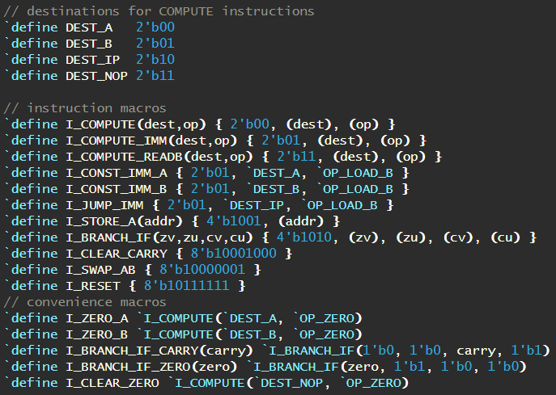
FEMTO-8 Macros
Interesting, but never used!

Slide 18
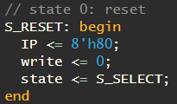
State Machine: S_RESET
Reset sets the instruction pointer to $80 (128), then transitions to select
$80 is halfway into our memory space of 256 bytes
In theory this is where our ROM code goes, RAM would be from 0-$7F

Slide 19
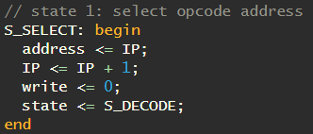
State Machine: S_SELECT
The output of IP is used to drive the address bus to read (write=0) opcode
Instruction pointer is incremented (need to correct if we branch)

Slide 20
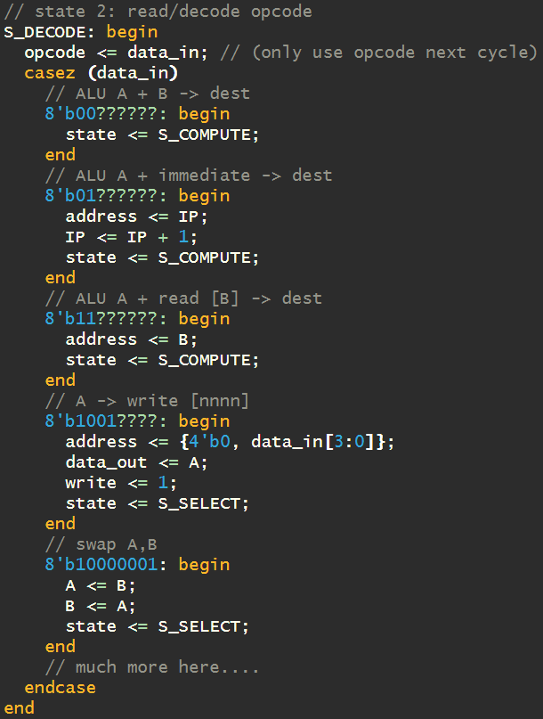
State Machine: S_DECODE
Decoding is the most complex logic in CPU
Using the current opcode available on the data bus (data_in) we determine what to do bases on the decoded bits
Notice that both swap and sta “instruction” opcodes can immediately be performed, and transition back to select
Verilog “casez” statement allows you to specify don’t care for certain bits – can match bit patterns
Two byte instructions

Slide 21
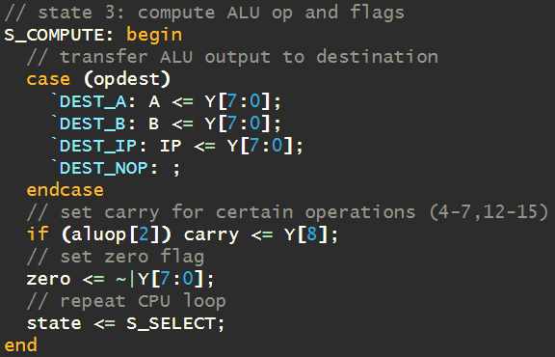
State Machine: S_COMPUTE
Grabs ALU output and writes it to desired destination
Computes the carry flag
Computes the zero flag by NOR-ing all of the ALU output bits

Slide 22
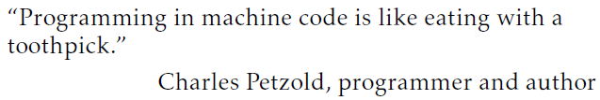
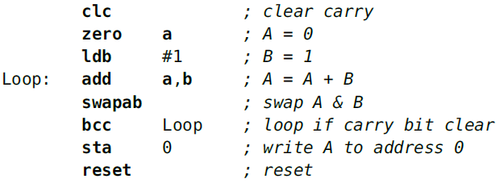
Chapter 27 – A Configurable Asm
A configurable assembler
The mapping of assembly mnemonics to resulting binary is configurable and specified by a single JSON file

Slide 23
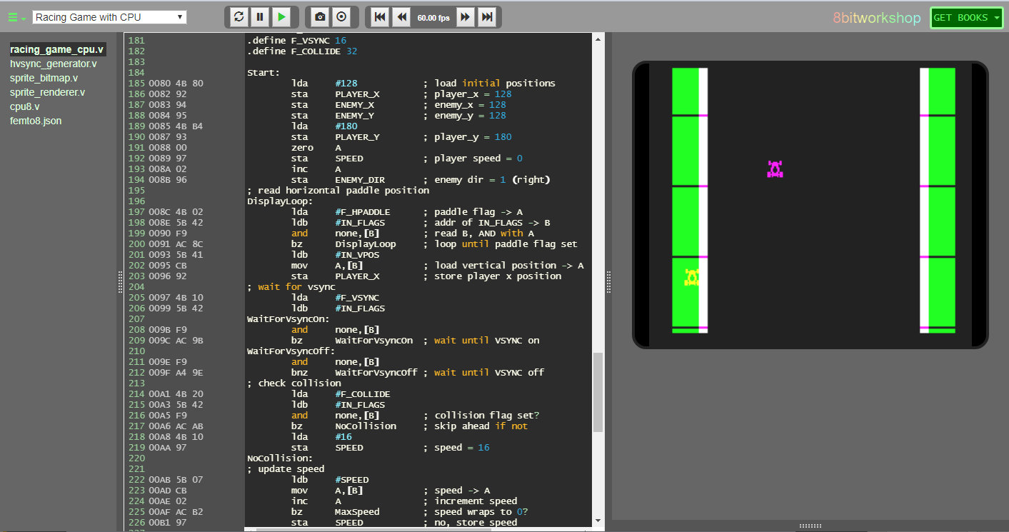
8 Bit Workshop IDE
Assembly Code to Convert for Custom “FEMTO-8” CPU
Hardware and Software Code Being Executed

Slide 24
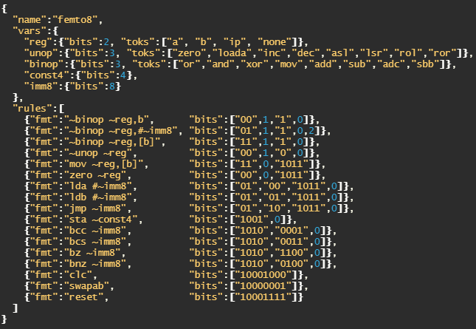
JSON-based Configuration File
Syntax
Data is in name/value pairs - separated by commas
Curly braces hold objects
Square brackets hold arrays
The mapping of assembly mnemonics to resulting binary is configurable and specified by a single JSON file
This provides a lot of flexibility to the custom CPU designer

Slide 25
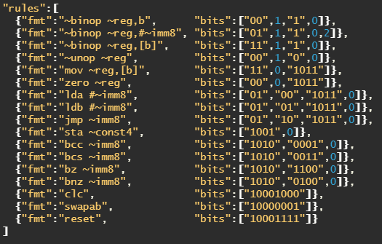
JSON Format: Rules
“rules” are defined by an array of objects, where each line defines a “transformation” from mnemonic to bits
(This table defines all mnemonics)
Configuration file format has a number of rules
Each rule has a format that matches a line of assembly code, and a bit pattern that is emitted when matched
Each rule effectively defines one of more assembly mnemonics

Slide 26
Example: swapab
Interchanges A and B registers
“swapab” is the human readable mnemonic, “10000001” is the resulting bit pattern needed and read by CPU
“fmt” attribute defines the pattern to be matched
If matched, the “bits” attribute defines machine code to emit

Slide 27
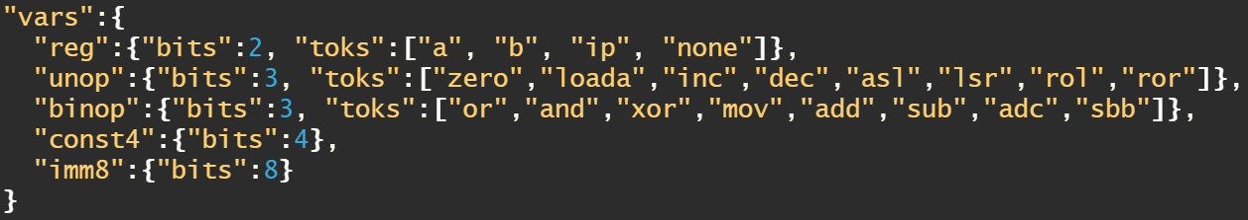
JSON Format: Variables
Can specify different types of variables
const4 can store 4-bit values
imm8 can store 8-bit values
To include variable in a rule, prefix the variable’s name with a tilde (~)
The instruction encoding process uses the variable’s value (which might be an explicitly defined token)
The value is determined by the index of the token array (e.g., 0 for first variable, 1 for second)

Slide 28
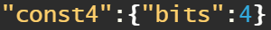
Example: sta
Rule
Stores register A into specified memory address
“sta” is the human readable mnemonic, “1001nnnn” is the resulting bit pattern needed and read by CPU
“fmt” attribute defines the pattern to be matched
Looking for a variable that will map to 4-bits
“bits” is specified to take 0th item (the value of variable) and concatenate with “1001” (it’s the “nnnn” part of the opcode)
Variable

Slide 29
JSON Format: Tokens
A variable’s value can be defined by tokens
Tokens map to value (register example)
a: 00
b: 01
ip: 10
none: 11
reg: register, unop: operation, binop: binary operation, const4: constant, imm8: immediate value

Slide 30
Example: mov
Example
Variable encodes a, b, ip, or none into 2-bits
Using this rule, for this instruction “mov a, [b],” results in “11” + “00” + “1011”
Variable
Rule
mov a, [b]
Notice that “mov” instruction is not explicitly shown in Opcode list (these are examples!)

Slide 31
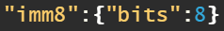
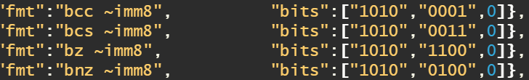
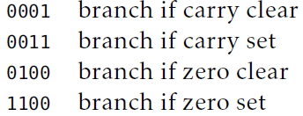
JSON Format: Branching
Branches are taken based upon CPU status (carry & zero flags)
Branches are specified by an immediate value (address), 8-bits wide – hence 256 bytes can be addressed
The immediate value is determined by the assembler
lower 4-bits of opcode (tttt)

Slide 32
Assembler Directives
.arch <arch> : load the file <arch>.json and configures the assembler
.org <address> : the start address of the ROM, as seen by the CPU
.len <length> : the length of the ROM file output by the assembler
Use this to match the output from assembler to length of the ROM array
.width <value> : the size in bits of a machine word (default is 8)
.define <label> <value> : define a label with a given numeric value
.data $aa, $bb, ... : include raw data in the output
.string .... : converts a string to machine words, and includes it
.align <value> : align the current IP to a multiple of <value>

Slide 33
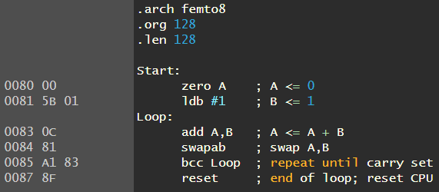
FEMTO-8 Complete Example
Starting address for output is $80 (128)
Loop label set to address $83
Branch on carry moves the instruction pointer back to $83 until carry not set

Slide 34
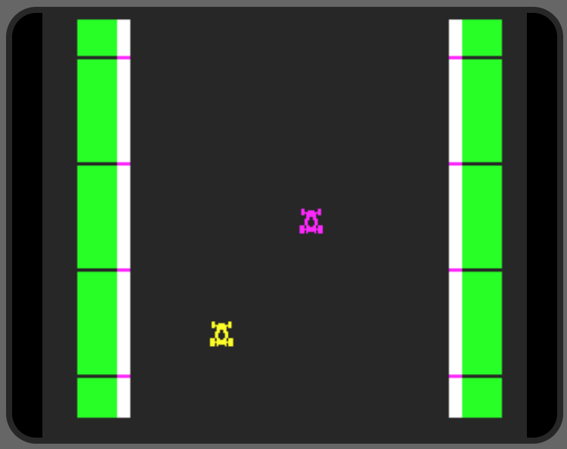
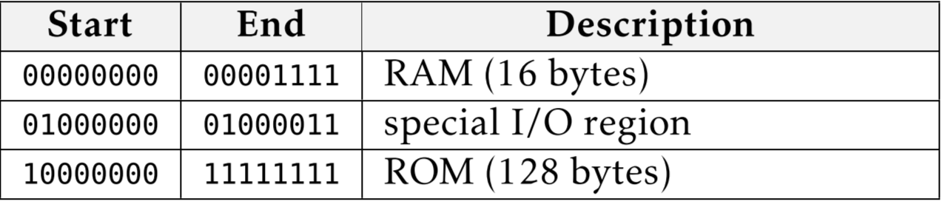
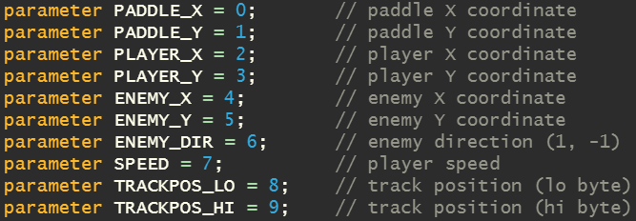

Chapter 28 – Racing Game w/CPU
Implement a racing game using FEMTO-8 CPU and two sprites
High level perspective
Memory map

Slide 35
Hardware

Slide 36
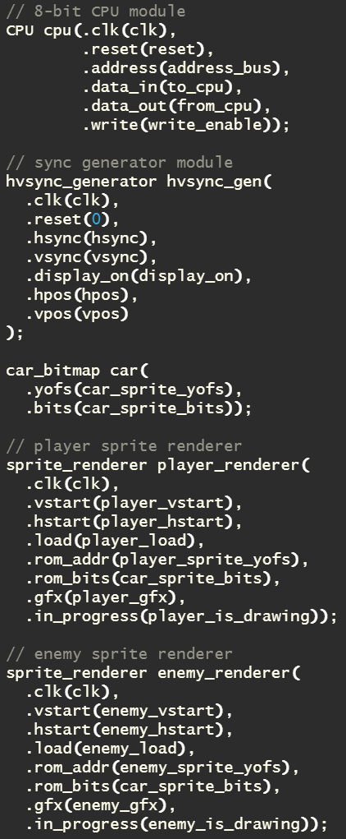
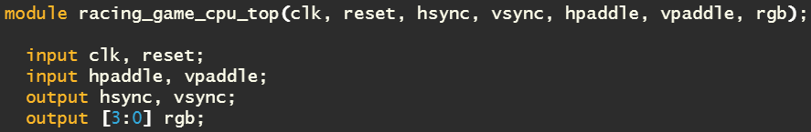
High Level Architecture
Architecture consists of a CPU, video sync generator, bitmap for a car and two sprite renderers
CPU can access RAM, some inputs and ROM
Sprite renderers read bitmap at different points of time, and supply output in terms of a gfx bit

Slide 37
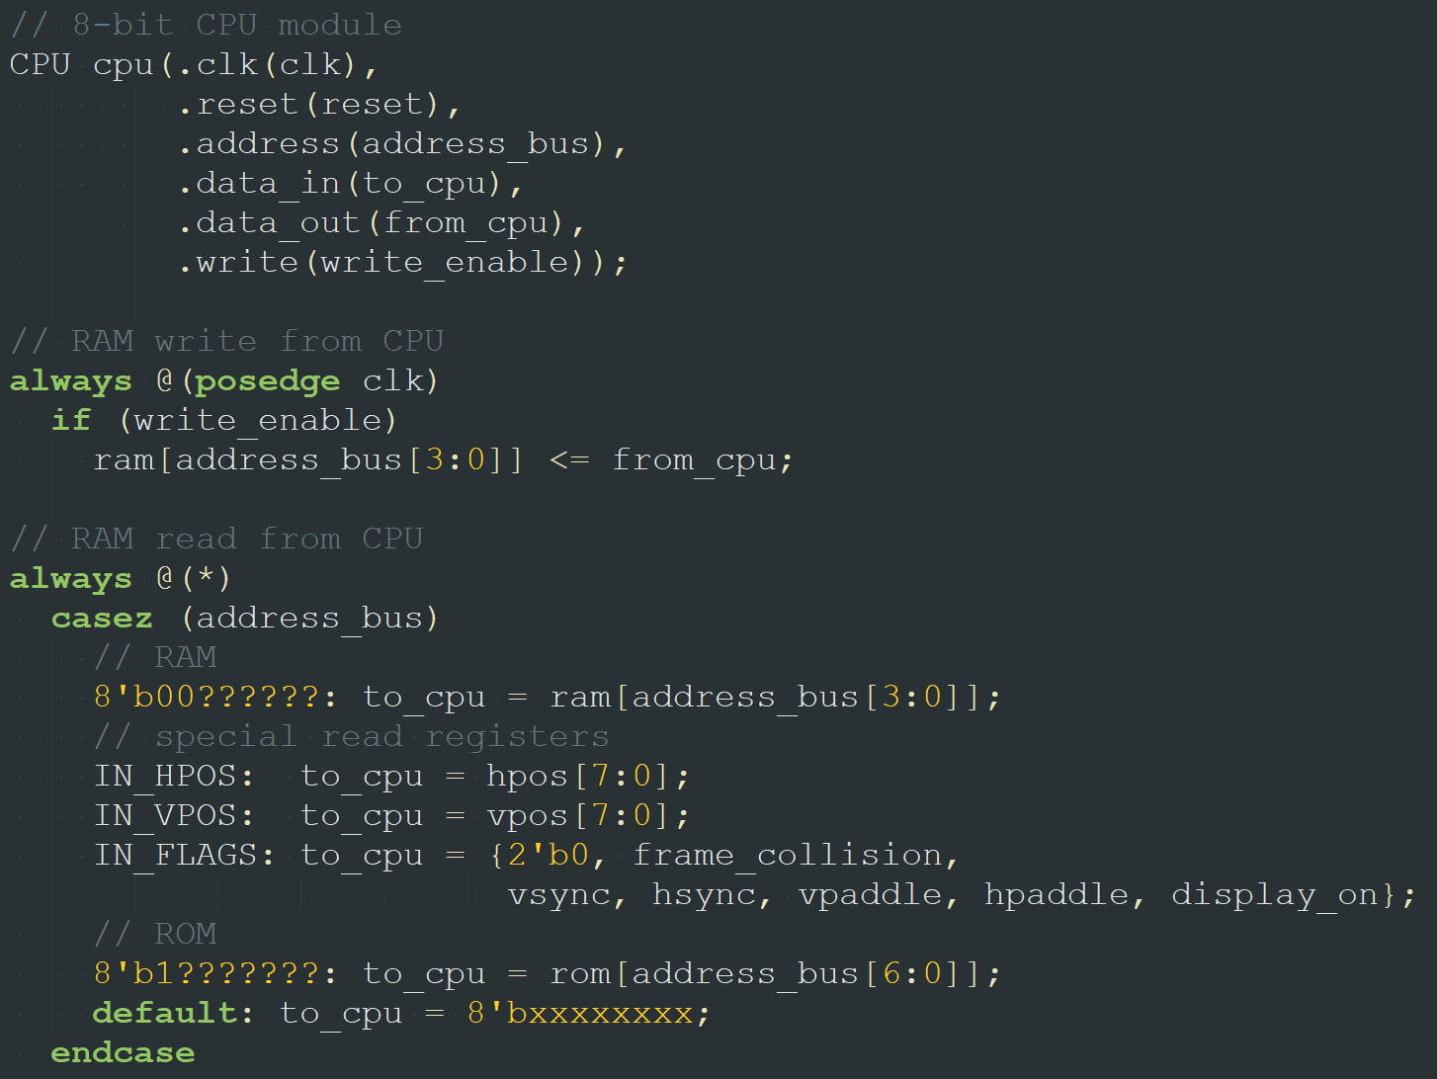
Multiplex CPU Data Bus

Slide 38
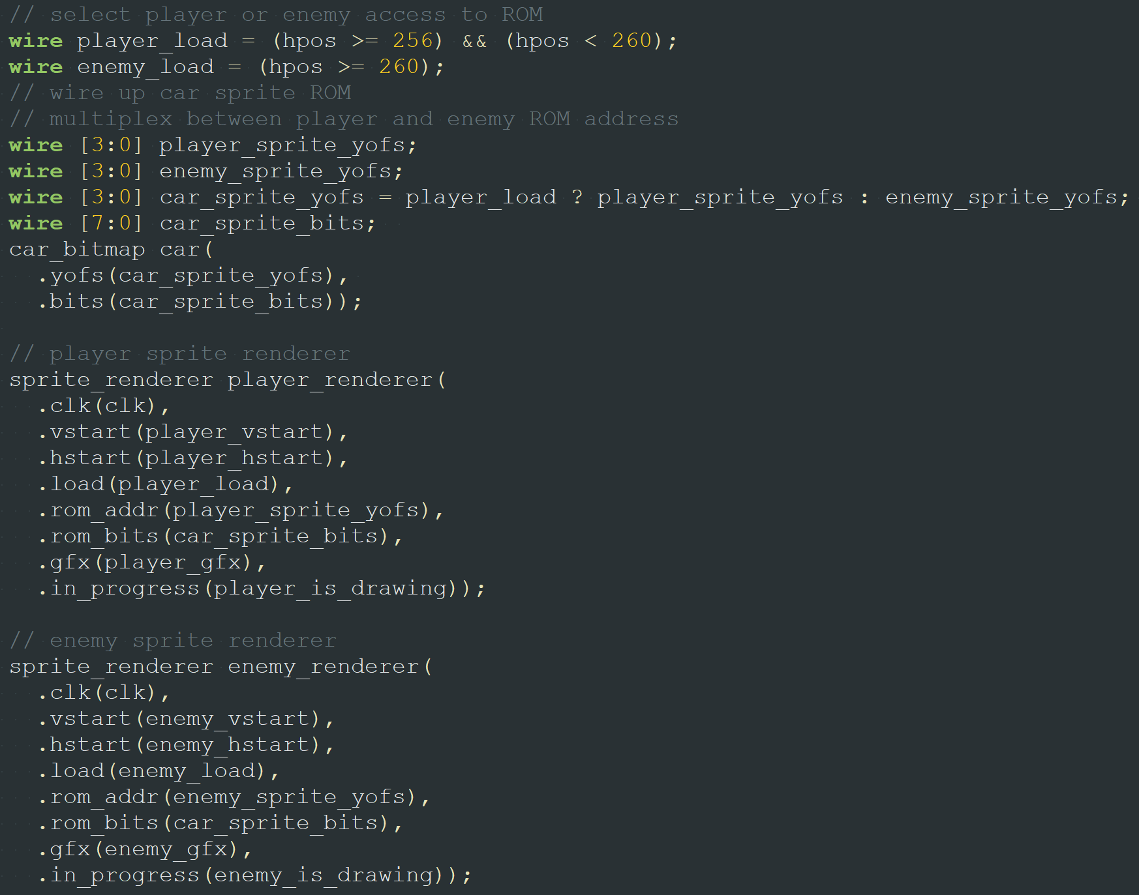
Sprite Rendering (Reading Bitmap)

Slide 39
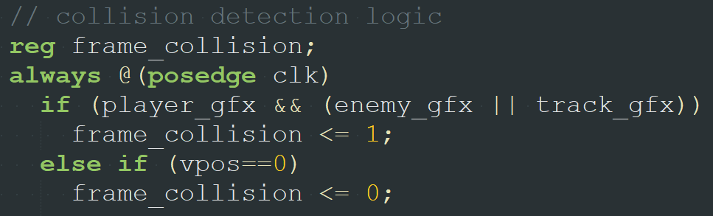
Collision Detection
frame_collision is set if player car collides with enemy car or track
Bit available to CPU at address $42 (i.e., IN_FLAGS) in memory map

Slide 40
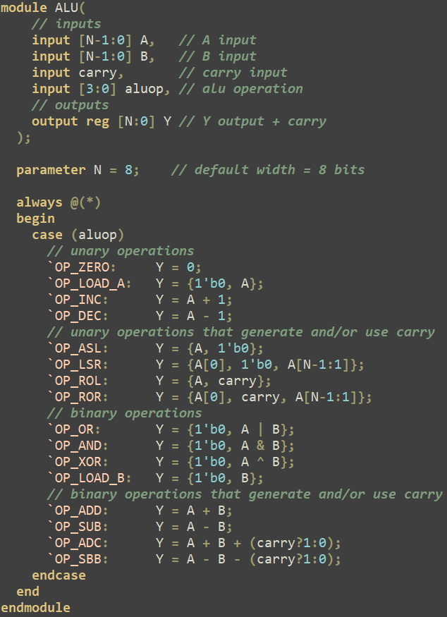
Synthesis Issues
Some assignments within CPU state machine need to be registered
Sprite renderer module needed this as discovered in previous homework
Tested changes within browser simulator first to see any obvious behavioral changes (nothing found)
Separated “ALU” module from CPU and modified slightly
Other ALU examples found “on web” always registered output result
Since it’s now registered, no need to do so within CPU reg [8:0] Y -> wire [8:0] Y

Slide 41
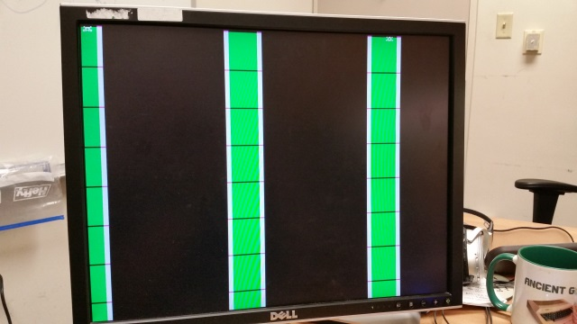
Initial Synthesis Result

Slide 42
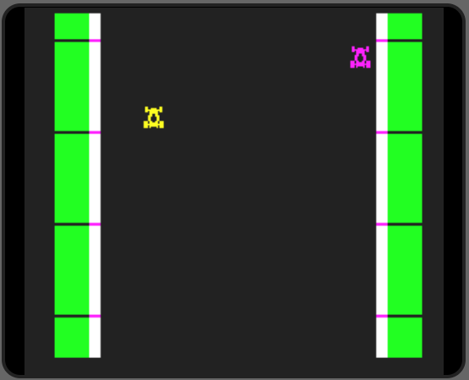
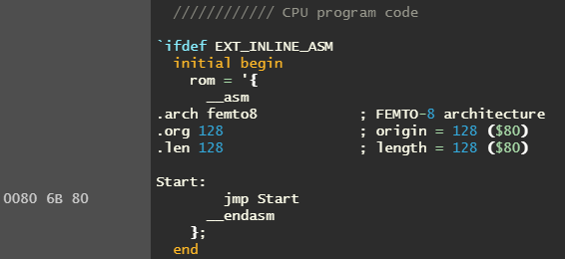
Doing Lots of Nothing
$6B
Keep CPU busy in endless loop while debugging hardware
Static display – CPU does nothing

Slide 43
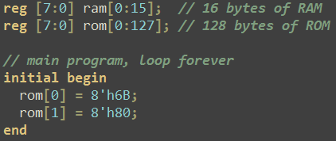
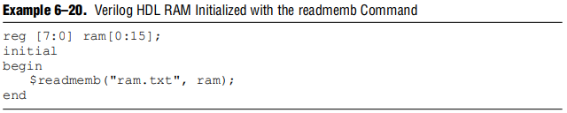
Initializing Registers (i.e., ROM)
ref: Recommended HDL Coding Styles, Quartus II 9.1 Handbook, Volume 1
(We will use $readmemh – reads memory file in hex format)

Slide 44
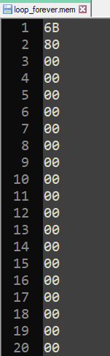
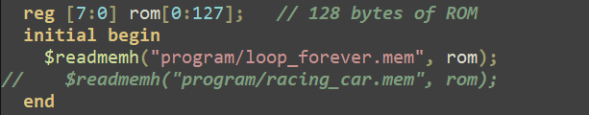
$readmemb / $readmemh
Reads a memory file
“b” means data values specified in binary
“h” means data values specified in hexadecimal
“mem” files are just text files with data

Slide 45
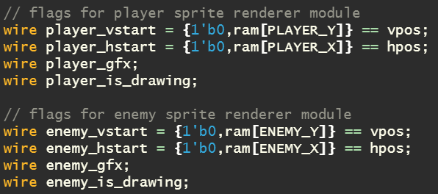
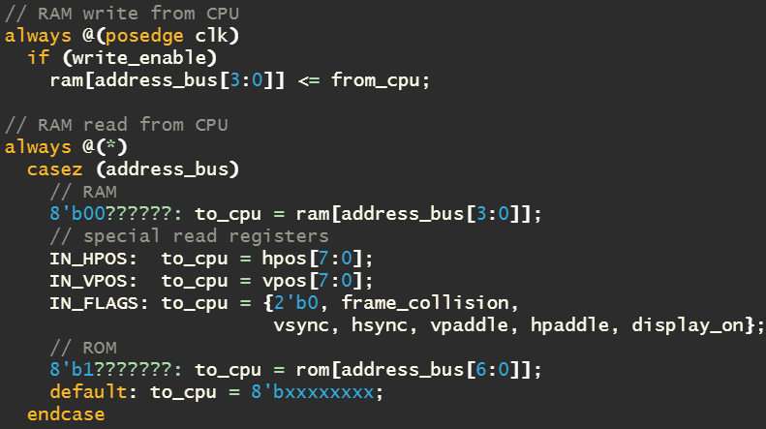

Warning! Accessing RAM Issue
Different aspects of the circuit accessing (reading and/or write) to the same “RAM” registers
Warning in Book!

Slide 46


Removing Direct RAM Access
Quick “fix” – check to see if sprites render correctly
Both sprites render correctly at the position specified, if hardcoded (as opposed to reading RAM)

Slide 47
Dual Ported RAM (With a Single Clock)

Slide 48
What is it?
Dual ported RAM is memory that allows any combination of independent read or write operations in the same clock cycle
In our game, the CPU updates car positions (writes) while the sprite renderers possibly read that value – at the same time (or the same clock cycle)
Using dual ported RAM resolves that issue

Slide 49


Dual-port RAM or DPRAM is a type of RAM that allow multiple reads and writes simultaneously at different addresses
Example: 64-bit x 8-bit Synchronous
Single clock
RAM data flows in through two ports (data_a, data_b)
RAM data flows out through two ports (q_a, q_b)
Independent write enable signals (we_a, we_b)

Slide 50


Racing Game RAM: 16 x 8-bit Synchronous
Single clock
RAM data flows in through two ports (data_a, data_b)
RAM data flows out through two ports (q_a, q_b)
Independent write enable signals (we_a, we_b)

Slide 51
Issue of Concern
Dual Ported RAM Partial Fix, We Really Need Something Different
Need simultaneous access to it
Want to read values from several locations all at once
If I can’t I need to sequence through reading values, looking for “matches” to trigger sprite renderer – in other words, I need another state machine to trigger the sprite renderers state machine

Slide 52


Separate Registers
Write player and enemy position information to their own registers directly accessible by decision logic
This is basically what was done for custom graphics chips – the chips had their own registers
Add these new registers to memory map

Slide 53

New Memory Mapping

Slide 54


Nearly 100% Working!

Slide 55

Issues of Concern
VGA is a 640x480 resolution screen
Therefore, player and enemy position is specified by 10 bits…. but the CPU can only read 8!

Slide 56


Resolution
Upgrade CPU to 10-bits
Or upgrade aspects of it, like reading and writing 10-bits of memory with internal 10-bit registers, but maybe instructions still stored as 8
Chapter 29 touches on some of this (CP1600 which powered the original Intellivision had 16-bit data and address buses, and instructions that were only 10-bits wide)
Limit size of playfield to 256x256
Turn off display outside of that range
Then trigger the loading of player and enemy cars bitmaps outside of that range

Slide 57
Software (I Need a Way to Assemble Code and Easily Initialize Registers)

Slide 58


Assembler Source Code
Entire assembler is written in TypeScript, in a single file (assembler.ts: 374 lines)
Appears to be written as a module
Developer supplied a test script (testasm.js: 116 lines) to check assembler

Slide 59



ASM.EXE Example
Validation
(Website)

Slide 60



Racing Car Game Program
Using assembler, generate opcodes and reformat hex values into a “mem” file to be loaded by Quartus to initialize register array

Slide 61
EOF

Slide 62
Parts
After Complete

